Slide 1
1.1.2 The Scientific Method
Process of the Scientific Method

Slide 2
The Scientific Method
The scientific method is a way to solve a problem
This is the method on which all projects should be based.

Slide 3
The Scientific Method
The Scientific Method involves the following steps:
Making observations
Formulating a hypothesis
Designing a controlled experiment
Collecting and interpreting data
Forming a conclusion
Comparing the conclusion with existing knowledge
Reporting and publishing the results
Developing theories and principles

Slide 4
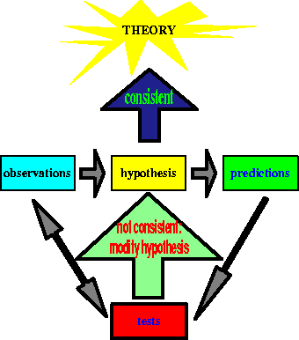
Steps in the scientific method
Observation
Question
Hypothesis
Test/Experiment
Results
Conclusions

Slide 5
Observation
You observe something using your senses or machines which are basically extensions of those senses.

Slide 6
Question
You ask a question about what you observed.
State it as a problem or question.

Slide 7
Learning check
What are the steps in the Scientific Method?

Slide 8
Hypothesis
Hypothesis: a testable‚ tentative answer to a question
(hypo = under‚ beneath; thesis = an arranging)
You predict what you think the answer to your question might be.The hypothesis is a testable explanation for what was observed.
The scientist tries to explain what caused what was observed.

Slide 9
Experiment
You figure out a way to test whether your hypothesis is correct or not. The outcome must be measurable. (quantifiable)
Record and analyze data.

Slide 10
Result
You do the experiment(s) using the method you came up with and record the results.
You repeat the experiment to confirm your results.

Slide 11
Learning check
What is the next step?
The Conclusion

Slide 12
Conclusion
You state whether your prediction was confirmed or not and try to explain your results.

Slide 13
Compare
You compare your conclusion with existing
knowledge.

Slide 14
Finally
You Report and Publish your results.
You Develop a theory or principle.

Slide 15
Need to know
State the process of the Scientific Method
Explain the following:
Observation, ■ Hypothesis,
Design Experiment,
Record & Analyze Data,
Conclusions,
Compare to Existing Knowledge,
Reporting, ■ Theory ■ Principle

Slide 16
1.1.2 The Scientific Method
Limitations of the Scientific Method

Slide 17
Limitations of the Scientific Method
Is limited by the extent of our basic knowledge
Is limited by our ability to interpret the results
is limited to what can be observed with the five senses e.g., what existed prior to the Big Bang and the known universe is outside of the realm of science to investigate
is limited to the present

Slide 18
Limitations of the Scientific Method
tells us “how” a process works, not “why” e.g., does not really explain why the Universe exists
inability to answer value-based questions involving “should”
may be affected by the emotional involvement of investigator
may be affected by time pressure for results

Slide 19
Limitations of the Scientific Method
inability to capture the full richness and complexities of the participants
limitations of our measurement instruments
ethical and legal responsibilities
Religious beliefs
we can never be sure all untested variables are controlled

Slide 20
Limitations of the Scientific Method
conclusions based on the experimental data must remain tentative
human personality traits are part of “real science”
scientists sometimes make mistakes
accidents, lucky guesses, intellectual powers, and controversies with others contribute strongly to scientific advances

Slide 21
Need to know
State the limitations of value of the Scientific Method

Slide 22
END

