Slide 1
1.3.6 Structural Role of Biomolecules

Slide 2
What does the ‘Structural Role of Biomolecules’ mean?
Structure = the way in which something is built e.g. timber structure, steel structure
Role = function/job or position
Biomolecules = carbohydrates, fats, proteins
Structural Role of Biomolecules = the function/job of carbohydrates, fats, proteins in making various parts of living things

Slide 3
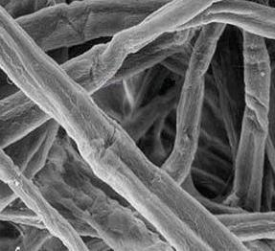
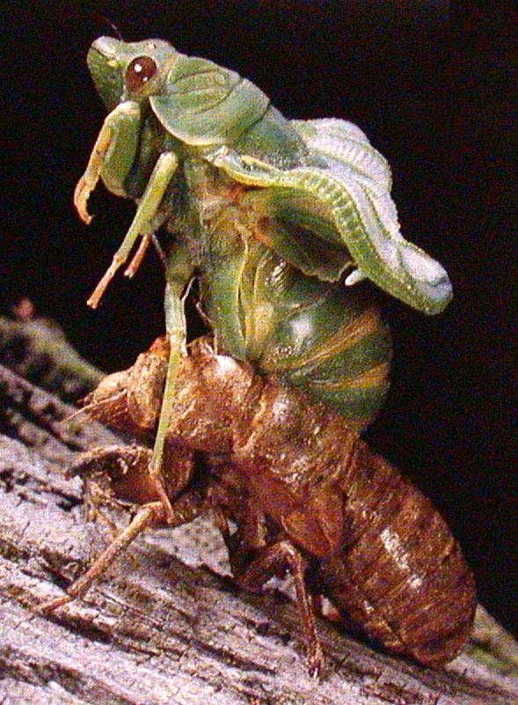
Structural role of Carbohydrate
Cell Structure
Cellulose (polysaccharide) found in plant cell walls
Chitin (polysaccharide) found in fungal cell walls and insect exoskeletons

Slide 4
Structural role of Proteins
Cell structure
Proteins are fibrous (threadlike) in nature.
They combine with phospholipids to from cell membranes (lipoproteins)
Keratin is the structural protein in skin, hair and nails
Myosin is the structural protein in muscle

Slide 5
Learning check
What does the ‘Structural Role of Biomolecules’ mean?
Structural Role of Biomolecules = the function / job of carbohydrates, fats, proteins in making various parts of living things

Slide 6
Structural role of Lipids
Cell Structure
Important storage molecules in organisms
Heat insulation – e.g. under the skin
Waterproof the body
Protection around body organs e.g. kidney, heart
Phospholipids and lipoproteins are major components in cell membranes
Myelin helps transmit messages in nerve cells

Slide 7
Learning check
What is the structural role of proteins?
Proteins are fibrous (threadlike) in nature.
They combine with phospholipids to from cell membranes (lipoproteins)
Keratin is the structural protein in skin, hair and nails
Myosin is the structural protein in muscle

Slide 8
Need to know
Structural Role of Biomolecules
State carbohydrates role as cellulose in cell walls
State proteins role as fibrous protein e.g. keratin or as myosin
State the role of lipids as Phospholipids in cell membranes

Slide 9
END

