Slide 1
1.4.6 Energy Flow

Slide 2
What is an ecosystem?
a community of living organisms interacting with one another and their non-living environment within a particular area, e.g. woodland, etc.

Slide 3
Energy Flow
Ecosystems are unable to function unless there is a constant input of energy from an external source.
Where does this energy come from?
The Sun

Slide 4
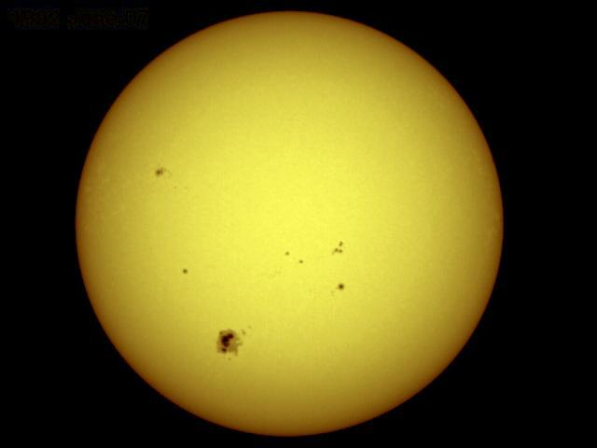
The Sun
The sun is the primary source of energy for our planet.

Slide 5
Energy Flow
is the pathway of energy transfer from one organism to the next in an ecosystem due to feeding, e.g. along a food chain
Feeding allows energy to flow from one organism to another in an ecosystem.

Slide 6
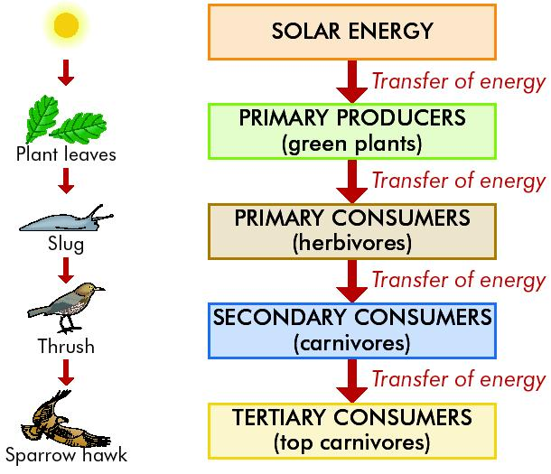
Energy flow in the ecosystem

Slide 7
Food Chain
Is a flow diagram that begins with a plant and shows how food/energy is passed through a series of organisms in a community.
Each organism feeds on the one before it.
A food chain ends when there is not enough energy to support another organism.
An example of a food chain:
grass → rabbit → fox.

Slide 8
Learning check
What is meant by primary source?
Main source
What is the primary source of energy?
The sun

Slide 9
A Grazing food chain
is one where the initial plant is living e.g.
Grass → grasshoppers → frogs → hawks
Honeysuckle → aphids → ladybirds → thrushes
Seaweed → winkles → crabs → herring gulls
Phytoplankton → zooplankton → copepod → herring

Slide 10
Grazing Food Chains

Slide 11
A Detritus food chain
is one where the chain begins with dead organic matter and animal waste (detritus) e.g.
Detritus → edible crab → seagull
Fallen leaves → earthworms → blackbirds → hawks

Slide 12
Detritus Food Chain

Slide 13
Food Web
This is a chart showing all the feeding connections in the habitat/ecosystem.
Constructed by showing the links between all the interconnecting food chains in the habitat.

Slide 14
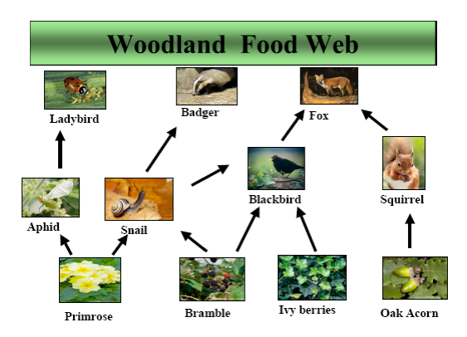
Food Web
the interconnected food chains in an ecosystem e.g.

Slide 15
Learning check
Energy flow/transfer through an ecosystem is achieved by …
Feeding

Slide 16
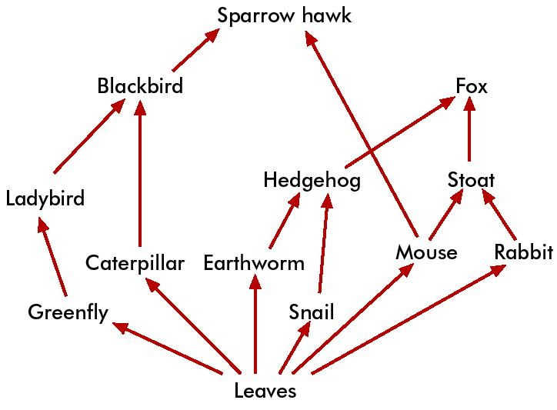
A woodland food web
Construct a two food chains (4 ‘links’) from the above food web

Slide 17
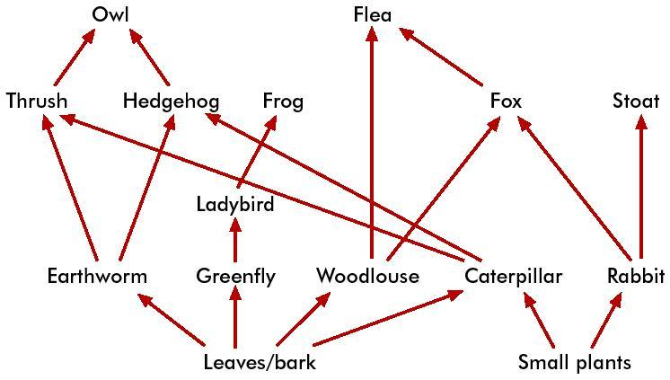
Another food web
What is the longest food chain you can construct from this food web?

Slide 18
Learning check
What is meant by a Grazing food chain?
is a food chain where the initial plant is living
Give an example
Grass → grasshoppers → frogs → hawks
Honeysuckle → aphids → ladybirds → thrushes
Seaweed → winkles → crabs → herring gulls
Phytoplankton → zooplankton → copepod → herring

Slide 19
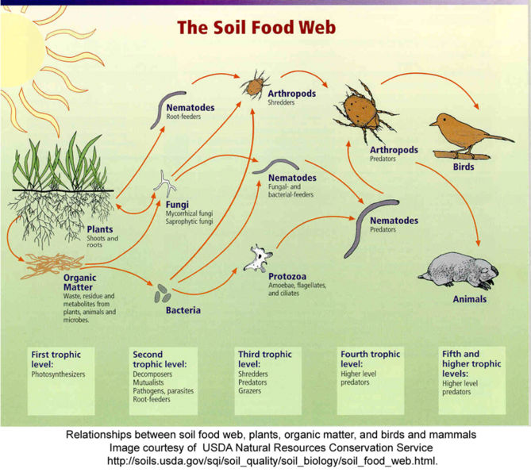

Slide 20
Producers
Producers are organisms capable of making their own food by photosynthesis, e.g. green plants.
Primary producers are the first members of a food chain

Slide 21
Consumers
Consumers are organisms that feed on other organisms. They cannot make their own food. There are three types:
Primary consumers – feed on producers
Secondary consumers – feed on primary consumers
Tertiary consumers – feed on secondary consumers

Slide 22
Woodland food chain
Honeysuckle → aphids → ladybirds → thrushes
Primary consumer
Secondary consumer
Tertiary consumer
Producer

Slide 23
Learning check
Construct a simple food web
Two food chains e.g.
Plant → caterpillar → thrush → fox
Plant → earthworm → blackbird → fox
Combine them to form a food web
Caterpillar
Earthworm
Thrush
Blackbird
Plant
Fox

Slide 24
Trophic Level
This refers to the position of an organism in a food chain.
Plants are at the 1st trophic level (T1) and
Herbivores occupy the 2nd trophic level (T2).
Carnivores that eat herbivores are at the 3rd trophic level (T3).
The 4th trophic level (T4) is often occupied by the top carnivore.

Slide 25
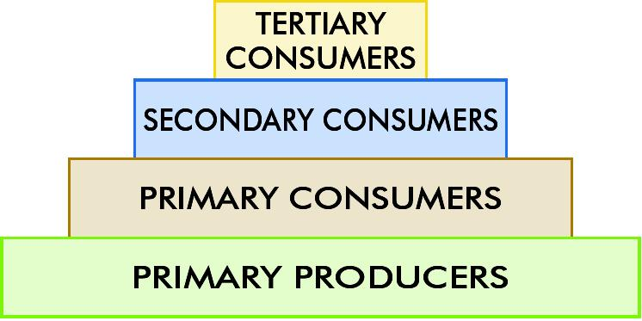
Trophic levels

Slide 26
Pyramid of Numbers
A diagram that represents the numbers of organisms at each trophic level in a food chain.
Bottom layer is the largest and represents a very large number of primary producers
The next layer smaller and represents a smaller number of primary consumers
The next layer – the no. of secondary consumers
The uppermost layer where there may be only one tertiary consumer

Slide 27
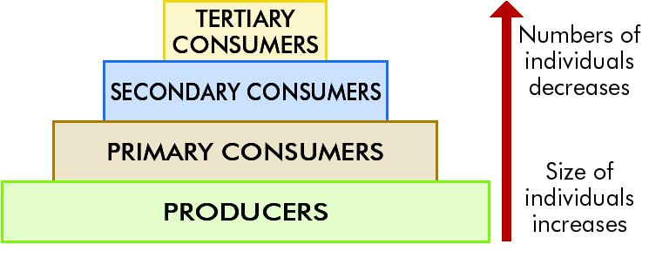
Pyramid of Numbers

Slide 28
Learning check
Explain the following terms:
Producer
organism capable of making its own food by photosynthesis
Consumer
organism that feeds on other organisms – cannot make their own food
Primary Consumer
organism that feeds on producers
Secondary Consumer
organism that feeds on primary consumers
Tertiary Consumer
organism that feeds on secondary consumers

Slide 29
To construct a pyramid of numbers
Count the primary producers and place them at the base of the pyramid
Count each consumer and include them according to their status (primary or secondary consumer) in the pyramid
The apex of the pyramid should include tertiary or top carnivores
Draw the pyramid so that the area/volume of each level is proportional to the number of organisms found

Slide 30
Learning check
What is meant by trophic level?
This refers to the position of an organism in a food chain.
T1 = 1st trophic level = Plants
T2 = 2nd trophic level = Herbivores
T3 = 3rd trophic level = Carnivores
T4 = 4th trophic level = (T4) Top Carnivore.

Slide 31
Learning check
Construct a pyramid of numbers and explain its use.
Construct:
1. …
2. …
3. …
4. …
Use:
attempts to show the energy structure of an ecosystem as a chart by counting the number of individuals at each trophic level

Slide 32
Need to know
Name the sun as the primary source of energy.
Name feeding as the pathway of energy flow.
Present a grazing food chain.
Present a food web.
Construct a pyramid of numbers.

Slide 33
END

