Slide 1
1.4.8 Nutrient Recycling

Slide 2
Nutrient Recycling (1/3)
There is a limited amount of nutrients on earth e.g. you are probably aware of the water cycle – where water is constantly being recycled in nature. There are similar cycles for all nutrients.
When plants and animals die, their nutrient content is not wasted.
Bacteria and fungi decompose the remains and release the nutrients back into the abiotic environment (i.e. into the soil, nearby water and air).

Slide 3
Nutrient Recycling (2/3)
These nutrients are then taken up by other plants and used to make new organic material.
This material is passed on down the food chains and is reused by all the chain members.
When death occurs for these members, the nutrients are again returned to the abiotic environment and the cycling of nutrients continues in this circular way.

Slide 4
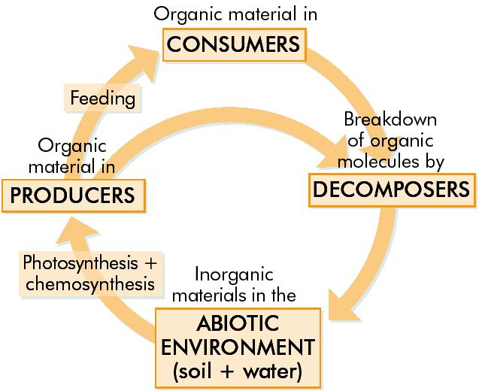
Recycling nutrients within an ecosystem

Slide 5
Nutrient Recycling (3/3)
This ensures that there is no real longterm drain on the Earth’s nutrients, despite millions of years of plant and animal activity.

Slide 6
In summary
Nutrient recycling is the way in which elements are continuously being broken down and/or exchanged for reuse between the living and non-living components of an ecosystem.

Slide 7
Carbon Cycle
Carbon forms part of all organic nutrients – carbohydrates, fats and proteins.
Carbon dioxide is removed from the environment by photosynthesis in plants, and under certain conditions, over long periods of time, some of these plants may form fossil fuels such as coal, oil, peat and natural gas.

Slide 8
Carbon Cycle
Carbon dioxide is returned to the environment by:
Respiration in plants, animals & micro-organisms.
Decay caused by micro-organisms.
Combustion i.e. burning fossil fuels

Slide 9
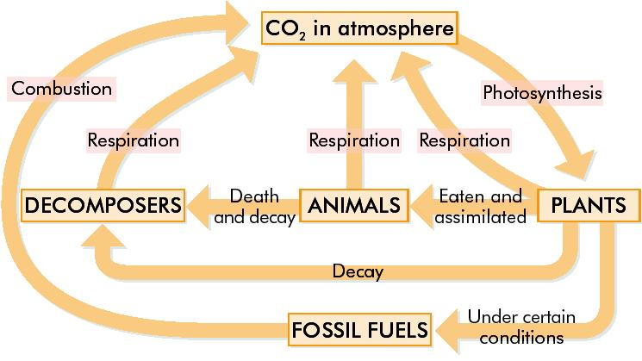
The Carbon Cycle (1/3)

Slide 10
Summary of Carbon Cycle
Click on the link below to see a summsry of the Carbon Cycle
The Carbon Cycle
For Animated Cycle click here
Flash
Shochwave
Click on this link to go to the next slide

Slide 11
Learning check
What is meant by nutrient recycling?
Nutrient recycling is the way in which elements are continuously being broken down and/or exchanged for reuse between the living and non-living components of an ecosystem.

Slide 12
Learning check
What process(es) remove Carbon dioxide from the atmosphere?
Photosynthesis
What process(es) add Carbon dioxide to the atmosphere?
Respiration
Decay
Combustion

Slide 13
The Nitrogen Cycle
All organisms need nitrogen for protein, DNA & RNA manufacture
78% of the Earth’s atmosphere is nitrogen gas, but it cannot be used in this form by plants and animals.
Nitrogen gas must first be ‘fixed’, i.e. changed to a suitable form (ammonia or nitrate) before it can be used.

Slide 14
Nitrogen Fixation
Nitrogen-fixing bacteria in the soil convert N₂ gas in the air into ammonia (NH₃). This accounts for the majority of all N₂ fixation.
Lightening storms and fuel burning in car engines produce nitrates, which are washed by rain into the soil water.
Nitrates are absorbed by plant roots and converted to plant protein.

Slide 15
The Nitrogen Cycle
Plant proteins are passed along food chains to become animal protein.
When organisms die, their proteins are converted to ammonia by bacterial decomposition.
Nitrifying bacteria in the soil then convert ammonia (NH₃) into nitrites (NO₂^{2 _}) then into nitrates (NO₃_).
Nitrates can be absorbed by other plants to continue the cycle.

Slide 16
The Nitrogen Cycle
Denitrifying bacteria convert soil nitrates into N₂ gas.
This is a loss of N₂ from the cycle.
Only happens in anaerobic conditions (when O₂ levels are low) – due to flooding or accumulation of sewage.
Nitrate also enters the cycle through the addition of nitrogen rich fertilisers to the soil – made industrially from nitrogen gas.

Slide 17
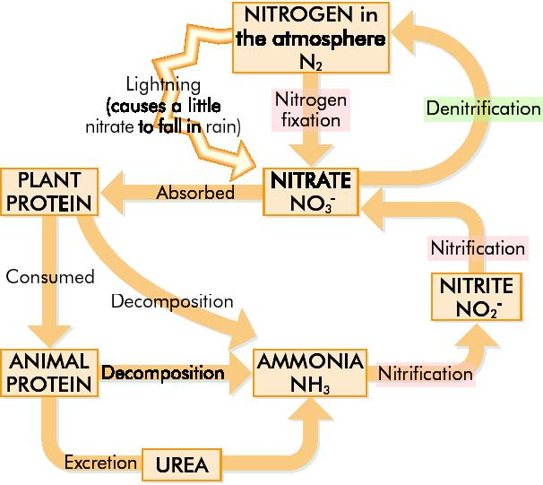
The Nitrogen Cycle

Slide 18
Summary of Nitrogen Cycle
Click on the link below to see a summsry of the Nitrogen Cycle
The nitrogen cycle
For Animated Cycle click here
Flash
Shochwave
Click on this link to go to the next slide

Slide 19
Summary of Nitrogen Cycle
Nitrogen in Air
Nitrite NO₂
Ammonia NH₃
6
7
4
5
1
8
5
Nitrate in Soil NO₃
Animal Protein
2
Plant Protein
3
Nitrogen Fixation & Lightning
Absorbed by roots and used by plants – Assimulation
Animal feeding, digestion & assimulation
Excretion: urea → Ammonia
Death & decomposition – putrefying bacteria
Nitrification: NH₃ → NO₂
Nitrification: NO₂ → NO₃
Denitrification: NO₃ → NO₂ → N

Slide 20
Learning check
Nitrogen gas must be ‘fixed’ – what does this mean?
Changed to a suitable form (ammonia or nitrate) before it can be used.
In what form is nitrogen absorbed by plants?
Nitrate

Slide 21
Learning check
What is nitrification?
The conversion of ammonia (NH₃) into nitrites (NO₂^{2 _}) then into nitrates (NO₃_).
What do denitrifying bacteria do?
They convert soil nitrates (NO₃_) into N₂ gas.

Slide 22
Need to know
Define the term: nutrient recycling by organisms.
Outline and draw the Carbon Cycle.
Outline and draw the Nitrogen Cycle.

Slide 23
END

