Slide 1
1.4.9 Human Impact on an Ecosystem 2
Conservation

Slide 2
Conservation
Introduction
What is Conservation?
Benefits of Conservation
One Conservation practice from one of the following areas:
Agriculture
Fisheries
Forestry

Slide 3
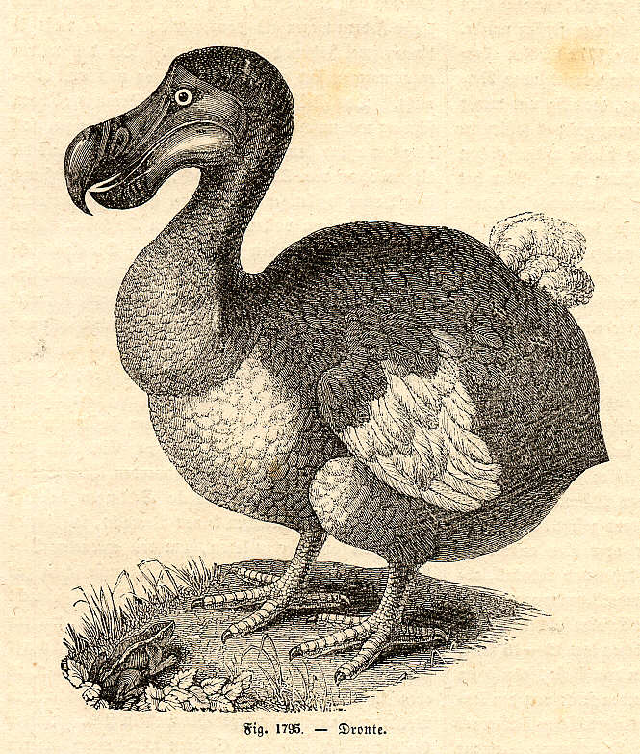
Conservation
Have you seen on of these recently?
It is a Dodo and has been extinct since 1681.
How did it happen?

Slide 4
What happened to the dodo? {Not examinable}
In 1598 Portuguese and Dutch sailors were the first people to live on the island of Mauritius.
With them they brought pigs, dogs, rats and even monkeys.
They killed dodos for food and by 1681 (83 years later) they were extinct.

Slide 5
Conservation
If you are connected to the internet click on the link below to view a web page on the Relationship of the Dodo Bird and the Calvaria Tree {Not examinable}
http://geology.wcedu.pima.edu/~enicksin/new.html

Slide 6
Learning check
Do you think any more species have become extinct since the dodo?
Yes
Now that we are aware of the extinction of species do you think it will ever happen again?
Yes
Why?

Slide 7
What is Conservation?
Conservation is the protection and wise management of natural resources and the environment.

Slide 8
Benefits of Conservation
Existing environments are maintained
Endangered species are preserved for reproduction
The balance of nature is maintained
Pollution and its effects are reduced

Slide 9
One Conservation practice from one of the following areas
Area | Conservation Practice
Agriculture | Mixed farming, Crop rotation Biological controls, Gene banks
Fisheries | Fishing Net size, Quotas, Re-stocking
Forestry | Re-planting, Broadleaf/conifer mix
There is a need for continual monitoring of the environment to ensure its protection and the wise management of its natural resources.

Slide 10
Learning check
What is conservation?
Conservation is the protection and wise management of natural resources and the environment
List some of the benefits of conservation
Existing environments are maintained
Endangered species are preserved for reproduction
The balance of nature is maintained
Pollution and its effects are reduced

Slide 11
Agriculture
One Conservation practice from one of the following areas is required:
Mixed farming
Crop rotation
Biological controls
Gene banks

Slide 12
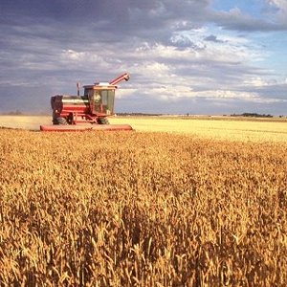
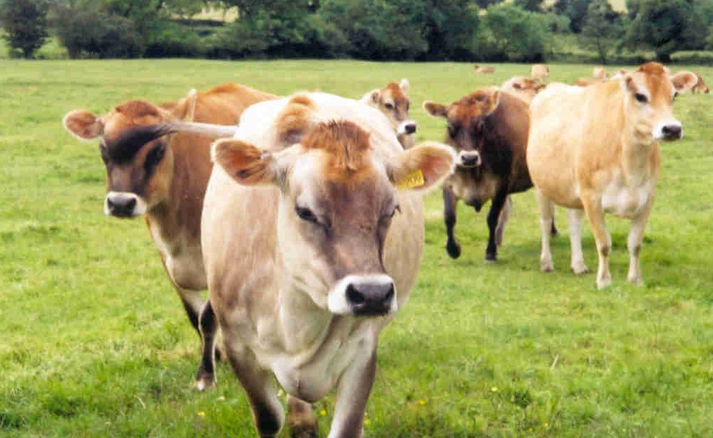
Mixed farming
What is mixed farming?
Farming system where both arable (crops) and pastoral (livestock) farming is carried out.

Slide 13
Conservation and Mixed Farming
Animals provide manure and help to maintain soil fertility and reduce the quantity of artificial fertilisers used.
Increases nutrients and soil water holding capacity and improves soil structure.
If rotations of various crops and forage legumes are used, they replenish soil nutrients
Reduce soil erosion.
Recycling wastes prevents nutrient losses
Go to next topic:
Waste Management

Slide 14
Crop rotation
What is crop rotation?
Alternating the crops grown in a given field from one growing season to the next.

Slide 15
Conservation and Crop Rotation
Different crops take different nutrients from the soil, some crops restore particular nutrients that others take away.
Crop rotation can also interrupt the life cycles and avoid the build up of pathogens and pests that often occur when one species is continuously grown.
Go to next topic:
Waste Management

Slide 16
Biological controls
What are Biological controls?
Biological control is a method of controlling pests (including weeds) and diseases in agriculture that relies on natural predation, parasitism or other natural mechanisms, rather than introduced chemicals.

Slide 17
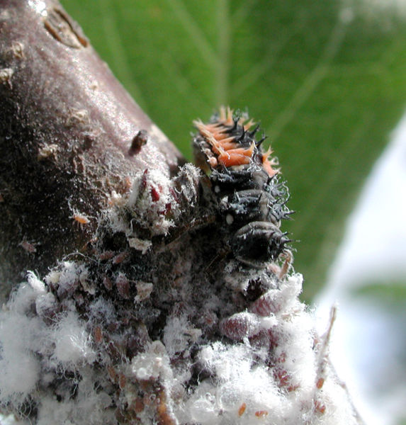
Conservation and Biological Controls
Ladybird larva eating woolly apple aphids
Advantages:
No chemicals used
No chemical residues left on plants
No leaching of chemicals into soil or watercourses

Slide 18
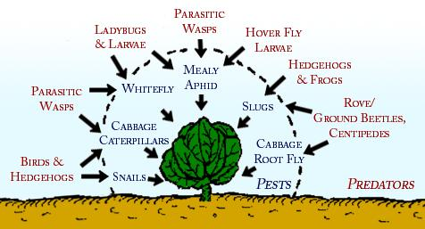
Conservation and Biological Controls
Diagram illustrating the natural enemies of cabbage pests

Slide 19
Conservation in action in Agriculture
Conventional agriculture uses straw burning and intensive tillage.
This has contributed to soil degradation through loss of organic matter, soil erosion and compaction.
These also have negative effects on the soil, water and air qualities. Global climate, wildlife and biodiversity are also affected.

Slide 20
Is soil degradation serious?
Soil degradation due to erosion and compaction processes is probably the most serious environmental problem caused by conventional agriculture.
About 10 million hectares of land are lost per year for agricultural uses, due to soil degradation processes
Note: 10,000,000 ha = 24,700,000 acres = 95,500 square miles. Ireland = 39,690 square miles

Slide 21
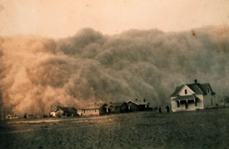
Can you suggest what should be done?
A Dust Storm:
soil being blown away
Stop straw burning
Reduce the intensity of tillage
Increase the amount of ‘set aside’ land
Go to next topic:
Waste Management

Slide 22
Gene Banks
What are gene banks?
Gene banks are a means of preserving genetic material, be it plant or animal.
In plants, this could be freezing cuttings from the plant, or the seeds themselves.
In animals, this is the freezing of sperm and eggs.

Slide 23
Conservation and Gene Banks
This is one way scientists have of preventing a gene family line from being wiped out.
In plants, it is possible to unfreeze the material and sow it, however, in animals, a living female is required for artificial insemination.

Slide 24
Conservation and Gene Banks
Artificial insemination of farm animals is very common in today's agriculture industry.
It provides an economical means for a livestock grower to breed their herds with males having very desirable traits, e.g. good beef quality, high milk yield, wool quality, etc.
Go to next topic:
Waste Management

Slide 25
Before we go to Waste Management – a quick Learning check
Give one Conservation practice from agriculture.
Go to next topic:
Waste Management

Slide 26
Fisheries
One Conservation practice from one of the following areas is required:
Fishing Net size
Quotas
Re-stocking

Slide 27
Fishing Net size
What is net mesh size?
This refers to how large or small the openings or spaces enclosed by the threads of a net are.

Slide 28
Conservation and Fishing Net Size
The use of small-mesh nets can result in too many young fish being caught
Using larger meshed nets to allow the young to escape, mature and reproduce

Slide 29
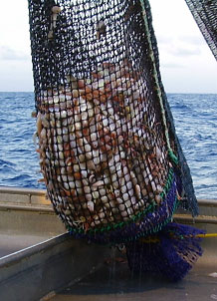
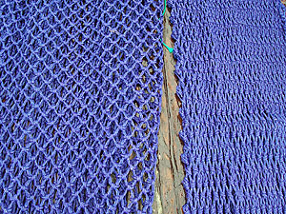
Different types of nets
Go to next topic:
Waste Management
Square mesh – does not alter its shape under tension – allows young fish to escape
Diamond mesh netting (left) – closes under tension (right) and prevents young fish escaping

Slide 30
Fishing Quotas
What is a fishing quota?
A fixed proportion of the total allowable catch allocated to each fishing nation.
This national quota allocation is further sub-divided into quotas for specific areas, seasons, fisheries or organisations, e.g. producers' organisations.

Slide 31
Fishing Quotas
Why have quotas?
Over fishing has reduced fish stocks at sea
Fish quotas (maximum amount allowed to be caught) have been assigned to different countries to ensure that enough fish are left to replenish the stock.

Slide 32
Conservation and Fishing Quotas
Helps to prevent the extinction of a fish species
Gradually increases fish stock and helps to re-establish populations
Attempts to maintain fishing at highest possible levels
Go to next topic:
Waste Management

Slide 33
Re-stocking
What is the purpose of re-stocking?
To achieve a permanent increase in the sustainable population of that species
Translocation of species into areas where they have not naturally occurred is not encouraged
Can you suggest why not?

Slide 34
Conservation and Re-stocking
Re-stocking attempts to maintain the balance in the ecosystem
Increases stocks for recreational fishing
Go to next topic:
Waste Management

Slide 35
Before we go to Waste Management – a quick Learning check
Give one Conservation practice from the Fishing Industry
Go to next topic:
Waste Management

Slide 36
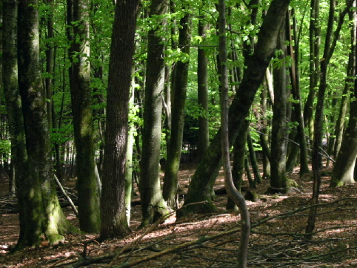
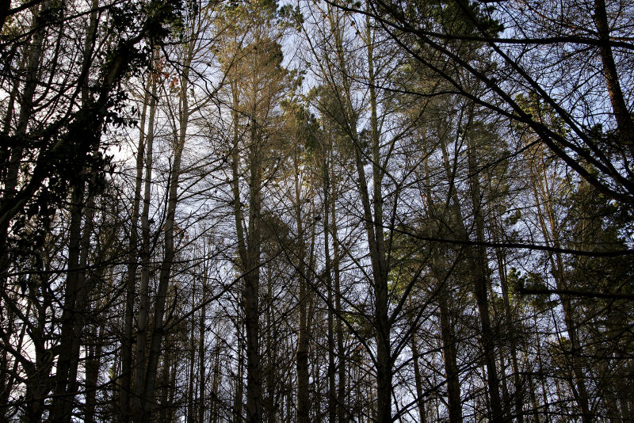
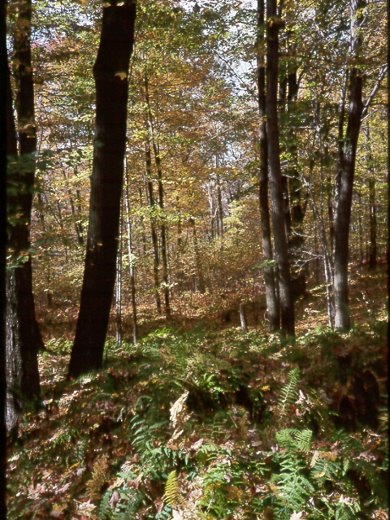
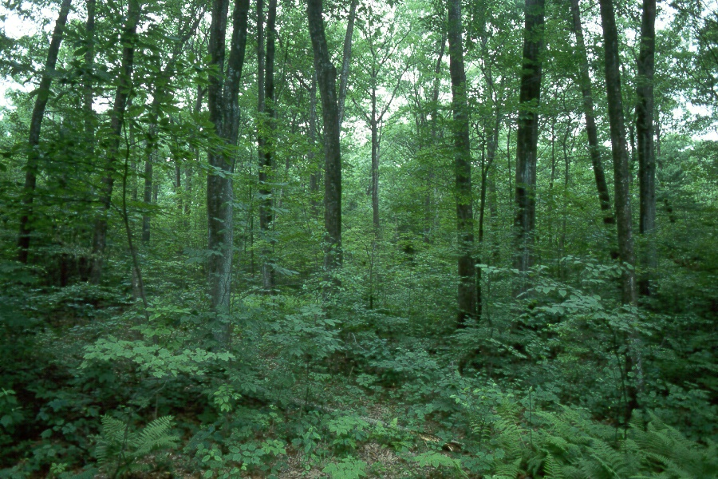
Forestry
Deciduous Forest
Coniferous Forest
Ground layer in open Deciduous Forest
Multi-layered Forest

Slide 37
Forestry
One Conservation practice from one of the following areas is required:
Re-planting
Broadleaf/conifer mix

Slide 38
Forestry Re-planting
Go to next topic:
Waste Management
Ensures continued health and growth of those forests that are periodically harvested for timber.
Allows foresters to choose the best species or mix for the forest.
Helps the forest regrow as soon as possible. Replanting is now a common practice after harvests and wildfire.
Forests that aren't replanted after a natural disaster, can take decades to re-establish.

Slide 39
Broadleaf/Conifer mix
Conifers rapidly provide timber for industry to replace imports
Broadleaf trees also provides timber for industry but at a much slower rate
Broadleaf planting forms native woodland and provides amenities, wildlife habitats, adds to the landscape and increases biodiversity

Slide 40
Conservation in action in Forestry
The selection and management of the tree species has an effect on the flora and fauna of the woodland
Include local species of broadleaved species in plantations
Leave greater areas of open space within plantations. This will encourage the growth of an understorey of shrubs by increased light penetration

Slide 41
Conservation in action in Forestry
Encourage the planting of woodland plots with the greatest woodland edge
Enhance the range of habitats of wooded areas by leaving some mature and dead wood; and increasing the number of water courses and ponds
Promote selective felling rather than clearfelling as the dominant harvesting technique

Slide 42
Before we go to Waste Management – a quick Learning check
Give one conservation practice fron the Forestry Industry

Slide 43
Need to know
Define the term: Conservation.
Outline any one practice of conservation from agriculture, forestry or fisheries.
Go to next topic:
Waste Management

Slide 44
END

