Slide 1
1.5.2 Ecology Equipment

Slide 2
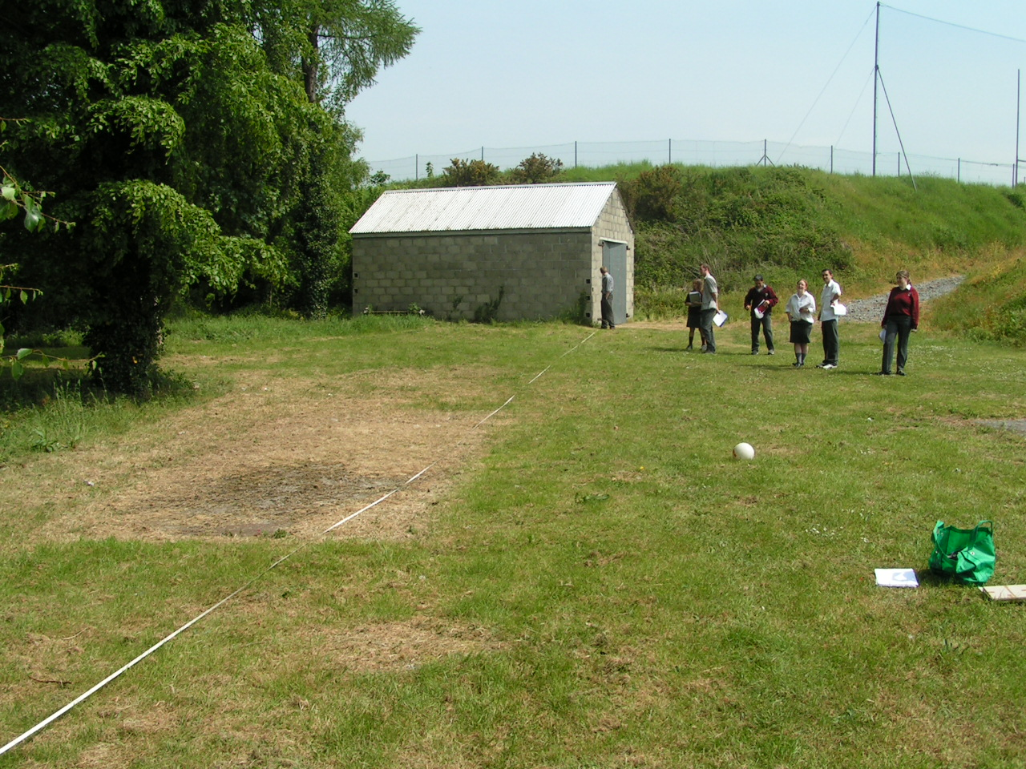
Students on a field trip

Slide 3
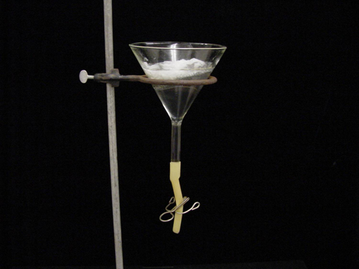
Baermann funnell
Used to extrract nematodes from a soil sample
Light and heat cause the organisms to move out of the muslin bag and into the bottom of the funnel where they are collected for examination under a microscope and identification.

Slide 4
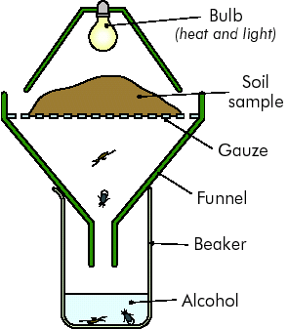
Tullgren Funnel
Used to extract animals from soil by heating the soil on one side
The animals are driven out of the soil by heat from a lamp and fall through a wire gauze

Slide 5
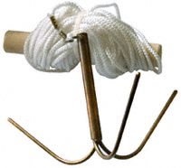
Grapnel
a plant grab. It consists of a sturdy pole with barbs at one end
When the grab is plunged into aquatic vegetation the plants become entangled in the barbs and can be pulled onto dry land.

Slide 6
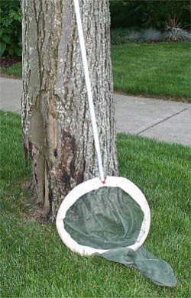
Insect net
Used for catching flying insects.
The net part should be sufficiently long so that the mouth frame seals off the end of the net which contains the catch when the net is laid flat.

Slide 7
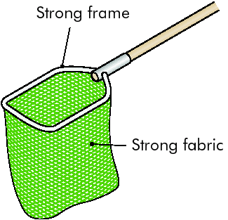
Fish Net
Used to collect small fish from pools and streams

Slide 8
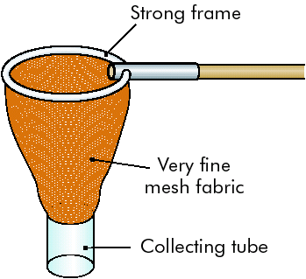
Plankton Net
Used to collect microscopic plants and animals from pools and streams

Slide 9
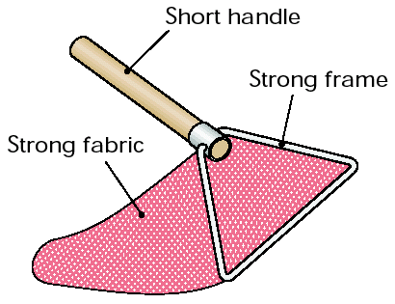
Sweep Net
Used to collect insects from tall grass

Slide 10
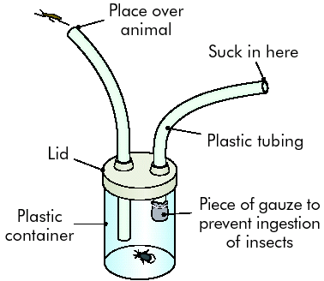
Pooter
Used for picking up very small animals.
Suck through mouthpiece (end of which is covered with muslin) and the animal is taken into jar through the hose

Slide 11
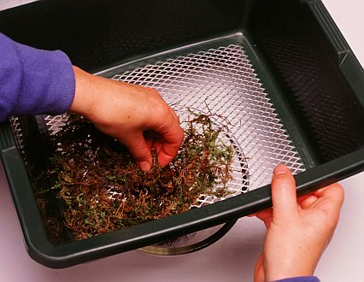
Sieve
Organisms that live in leaf litter can be extracted by using a sieve with a mesh size of about 5 mm.
Use the sieve over a beating tray or a large sheet of paper.

Slide 12
Cryptozoic trap
A piece of wood or stone which is left on the ground.
After a suitable interval, animals such as slugs, woodlice, centipedes and millipedes will be found underneath.

Slide 13
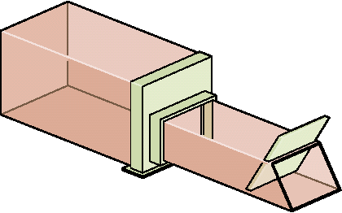
Mammal Trap
Used to collect small mammals
e.g. mice, voles, etc.

Slide 14
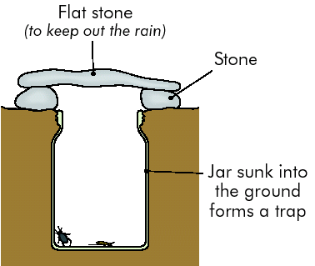
Pitfall Trap
Jam jar buried in ground and covered with raised flat stone.
Used to collect ground surface animals insects, nocturnal and diurnal
e.g. spiders, centipedes, woodlice, beetles, etc.

Slide 15
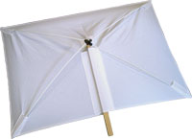
Beating tray
This is a white tray, cotton sheet or large sheet of white paper.
It is placed under a bush or tree branch.
The tree branch is shaken suddenly and vigorously.
Insects and other invertebrates fall onto the tray.

Slide 16
Settlement tray
This is used in freshwater.
It consists of a shallow wooden frame which has a metal gauze or perforated zinc sheet bottom.
The tray is placed on the bottom of a pond or stream and is covered with gravel or mud and is left in place for a month or more.
It is then carefully removed and examined and the organisms which have settled on it are recorded.

Slide 17
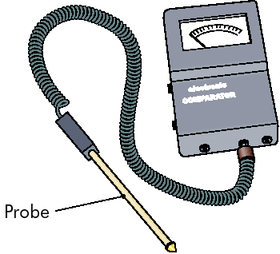
Environmental Comparator
An electronic device often with a digital display
Used for accurate measurement of different environmental abiotic factors e.g. temperature, pH, light intensity, etc.

Slide 18
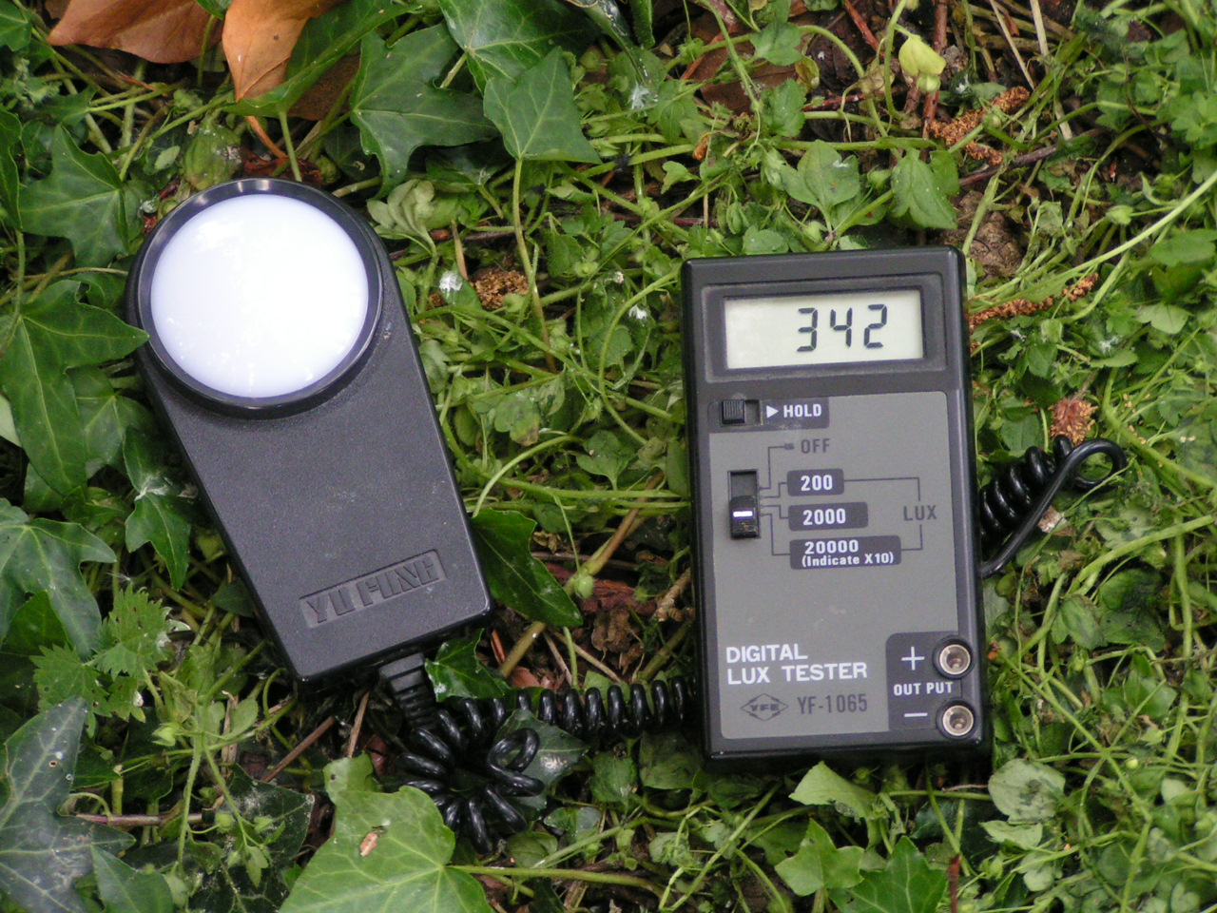
Light meter
Used to measure the light intensity

Slide 19
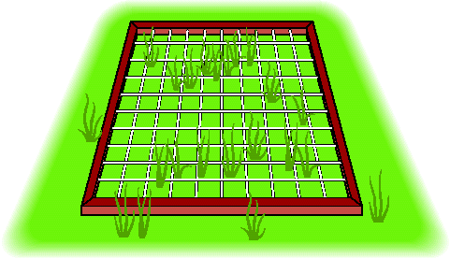
A Quadrat
A frame that forms a known area usually
0.5m X 0.5m
= 0.25m²
Usually square shaped
Can be used to measure:
Frequency and
% Cover

Slide 20
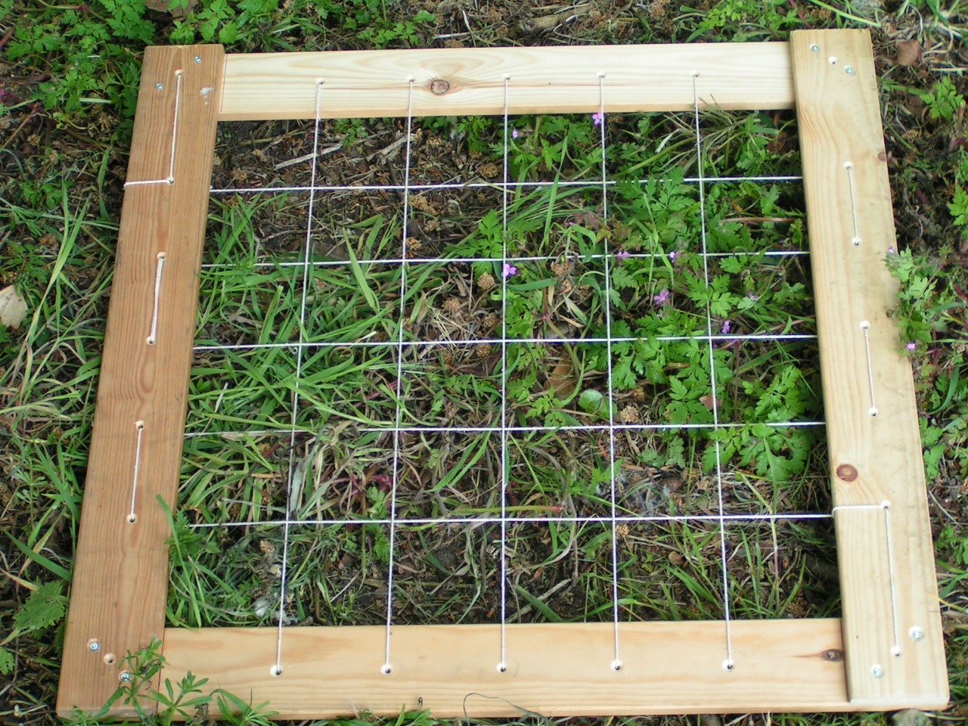
Homemade Quadrat Internal area = 0.25m²

Slide 21
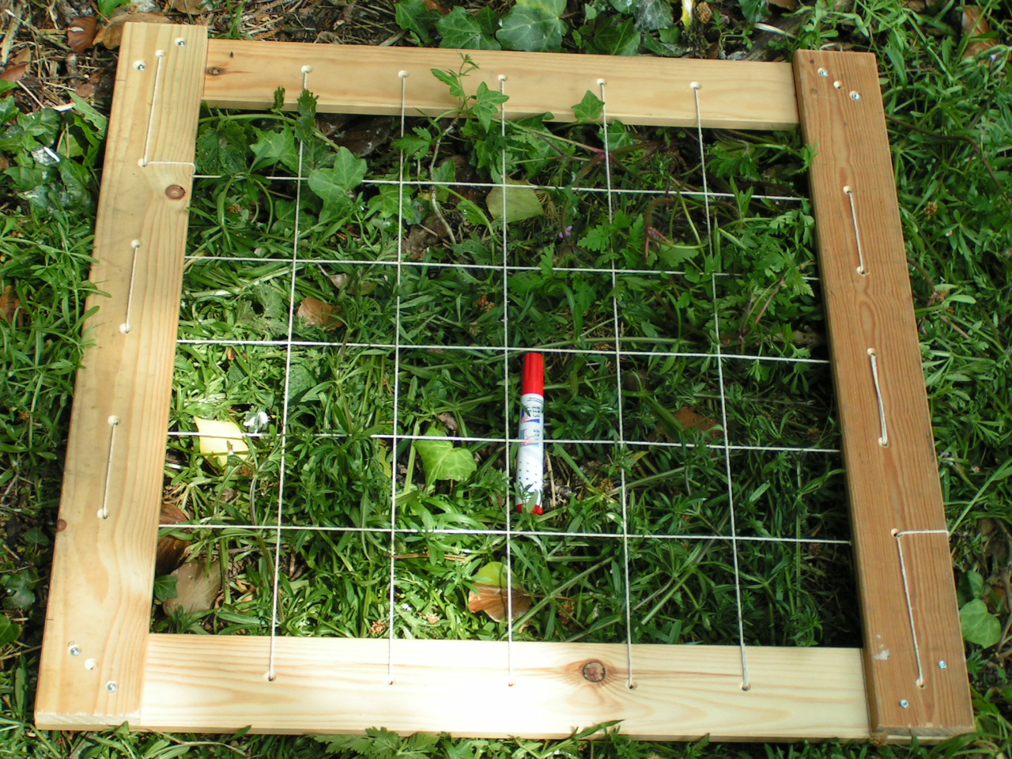
Quadrat with marker

Slide 22
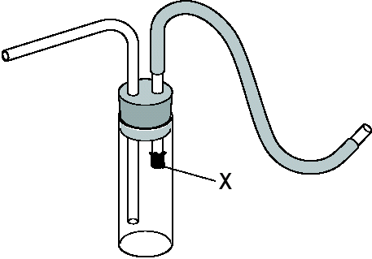
1. Name it 2. What is it used for? 3. How do you use it?

Slide 23
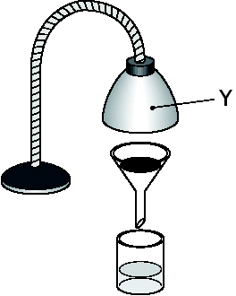
1. Name it 2. What is it used for?

Slide 24
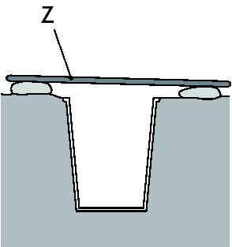
1. Name it 2. What is it used for?

Slide 25
END

